Slide 1
Self- vs. Traditional Publishing
By: Author Dan Lawton
www.danlawtonfiction.com

Slide 2
Agenda
Welcome
Introduction: My Story
Introduction to Self-Publishing
Introduction to Traditional Publishing
Self- vs. Traditional Publishing Summary
Questions

Slide 3
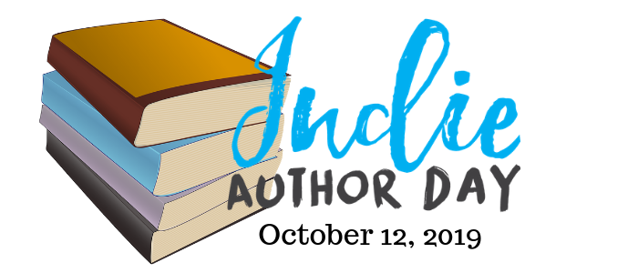
Notes:
Welcome everyone to the 4th annual event that’s going on around North America today.
Thank them and the library and for everyone who supports independent and self-publishers authors nationwide.
According to indie author day dot com, libraries in Sandown and Raymond also participating in NH today.
Though it’s not on their website. So we may be the only ones today.
No NH participants last year. 2017 Keene. 2016 Keene and Merrimack.
Mix of traditionally published, self-published, non-published, and dreamers in the audience. Lots of perspectives today, lots of journeys, lots of learning.
For those who haven’t yet written anything, you’ll learn so much today. It may be overwhelming. But a quick summary about the elements of getting to market are this:
Research/plot if necessary, depending on book type
Write, edit, rewrite
Getting published
Lots of ways. Literary agents and traditional. Independent presses. Self-publishing. Hybrid publishing. Digital-only. We’ll talk about some of them today.
Ongoing marketing
Repeat

Slide 4
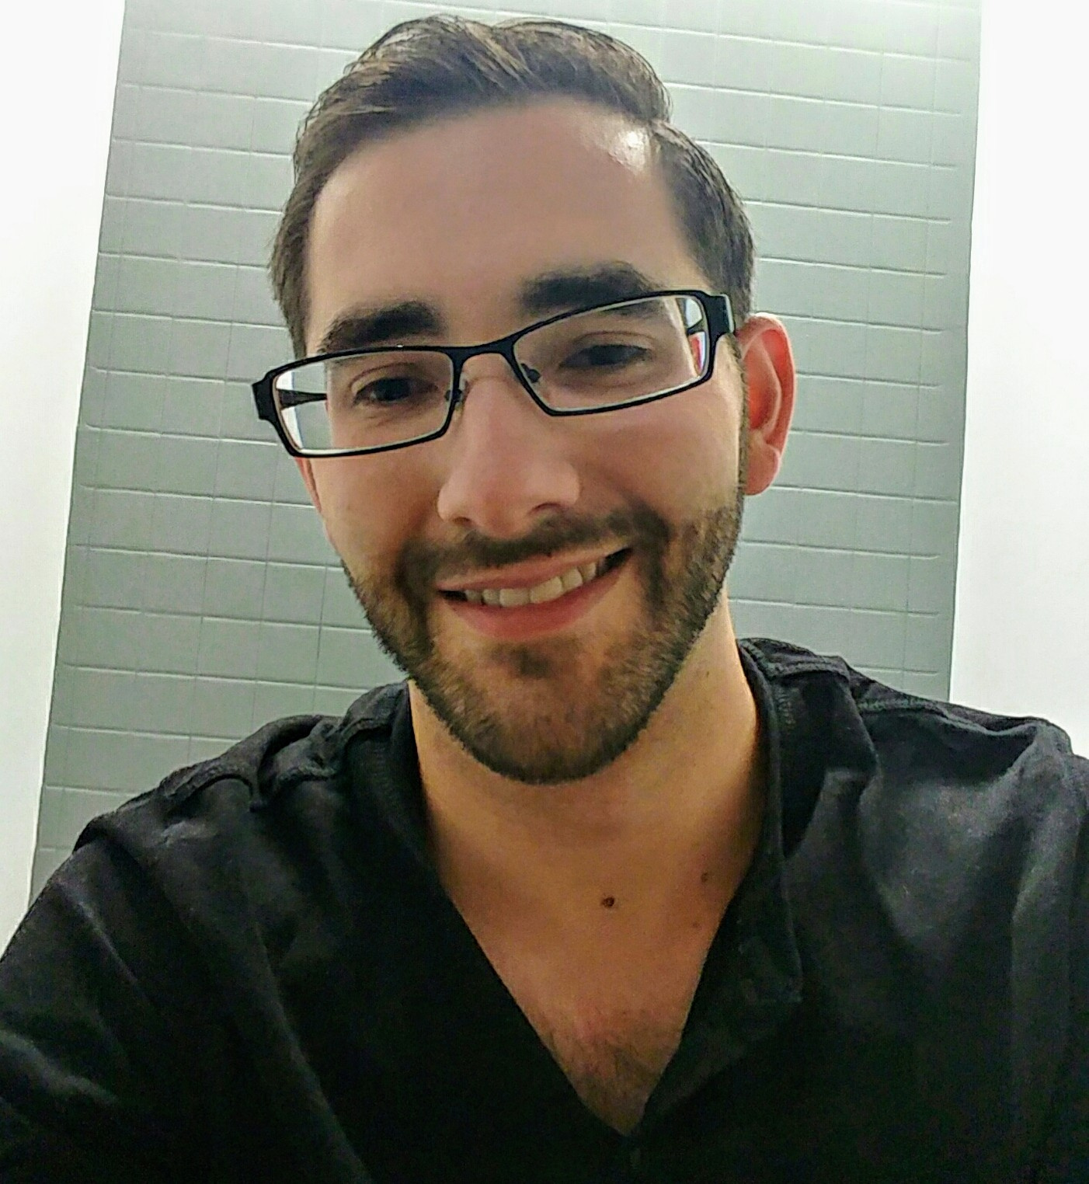
Introduction: My Story
Dan Lawton is a thriller, suspense, and mystery writer from New Hampshire. He’s an active member of the International Thriller Writers (ITW) Organization and the New Hampshire Writer’s Project. By day, he's an editor for an advertising agency in Manchester. Dan's latest novel, Plum Springs, is the winner of the 2019 New Hampshire Writers' Project Readers' Choice Awards (Fiction category). His first novel, Deception, was named one of the best thriller novels of 2017 by the Novel Writing Festival. Website: www.danlawtonfiction.com Email: info@danlawtonfiction.com Twitter/Instagram: @danlawtonauthor Facebook: facebook.com/danlawtonfiction
Notes:
Little about me and why I’m here. Bio in the screen.
Began writing young. Late middle school. Won poetry awards, wrote songs, journalism in high school
Education
NEC
Journalism, not fiscally feasible, knew I wanted to do something with writing
Lots of creative and professional writing
Creative Writing Workshop, Scriptwriting
Began first story summer of junior year
BA in Communications, minor in Business for career feasibility, Summa Cum Laude
After college, Radio Shack then BittWare, learned a lot about technology and about avenue for professional writing
Terex Tech Writer
Holden Proposal Writer
GYK Proofreader and Copy Editor and Copywriter
Writing and editing helped get me super competitive job
Meanwhile, wrote 5 manuscripts before my 30th birthday, 4 published
Self-published twice, traditional published twice, acquired a literary agent, currently shopping 5th (3 offers on the table)
Freelance editing

Slide 5
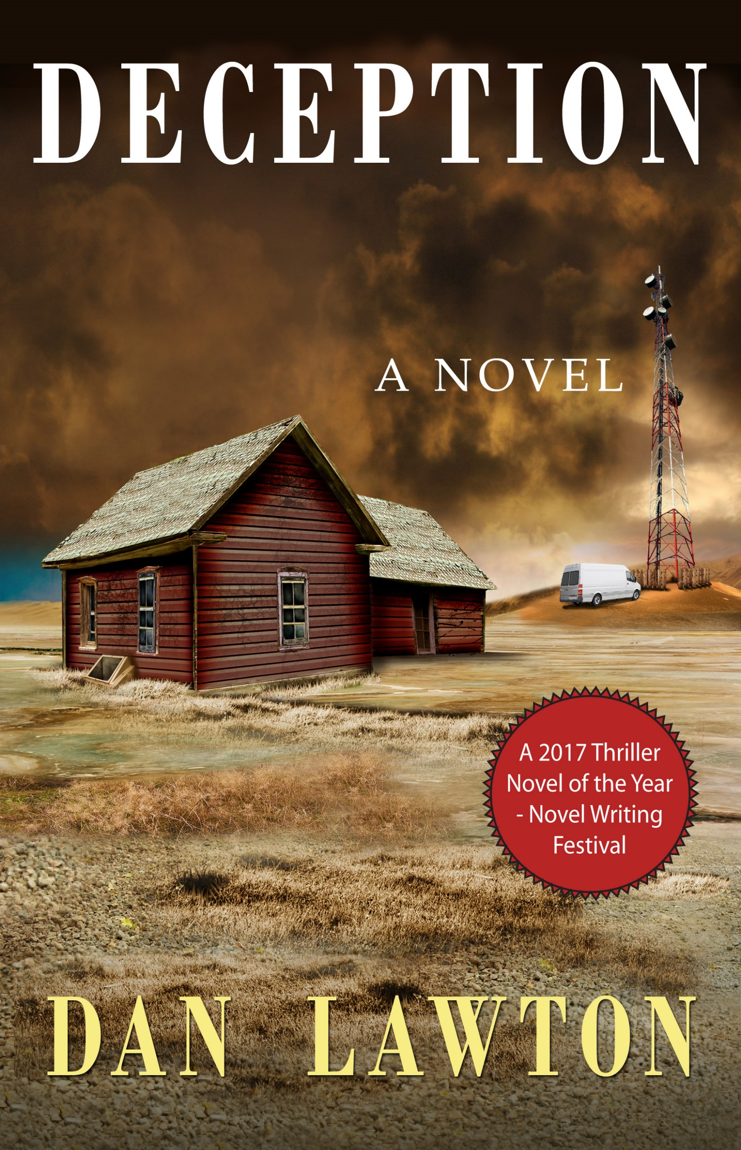
A heist goes bad when greed, a love triangle, and ulterior motives take over. Billy is a local cop, the son of the former Sheriff who was gunned down in cold blood. Billy has made it his mission to find out why. Joining forces with Alicia—a mysterious, benevolent, and beautiful Cuban immigrant—and his well-meaning but mentally unstable brother, they seek vengeance and fortune. George is recruited against his will and forced to help the trio with the promise of the life he’s always wanted on the other side. But when Alicia tears he and Billy into a boiling love triangle, real motivations are exposed. With tensions mounting and the danger intensifying, the group must decide what’s more important: money, family, or love. The problem is, each one of them has a different answer. And not everyone is guaranteed to make it out alive. Who will? Or worse, who won’t?
Notes:
Synopsis on the screen. It’s a thriller.
Took roughly 2 years to finish. At least four drafts. First draft a nightmare. Finished in November 2014.
Industry formatting
Word count issue (went back and wrote second perspective)
Incorporated feedback from some beta readers
Had Staples print it and manually red penned myself
Researched literary agents and how to query them (I’ll get into that more later)
One bite from Mark Gottlieb from Trident Media Group (talk about him more later too, ironically)
Didn’t submit to any publishers. Not sure if I didn’t know how, or if I could. Was also anxious to get it out there.
Self-published in June 2015
Researched the process (I’ll get more into later)
Hired a cover designer (Craigslist post)
Didn’t hire an editor but had a bunch of people proofread
Initial success
Newspaper articles, events (LRCC, book signings) decent early sales

Slide 6
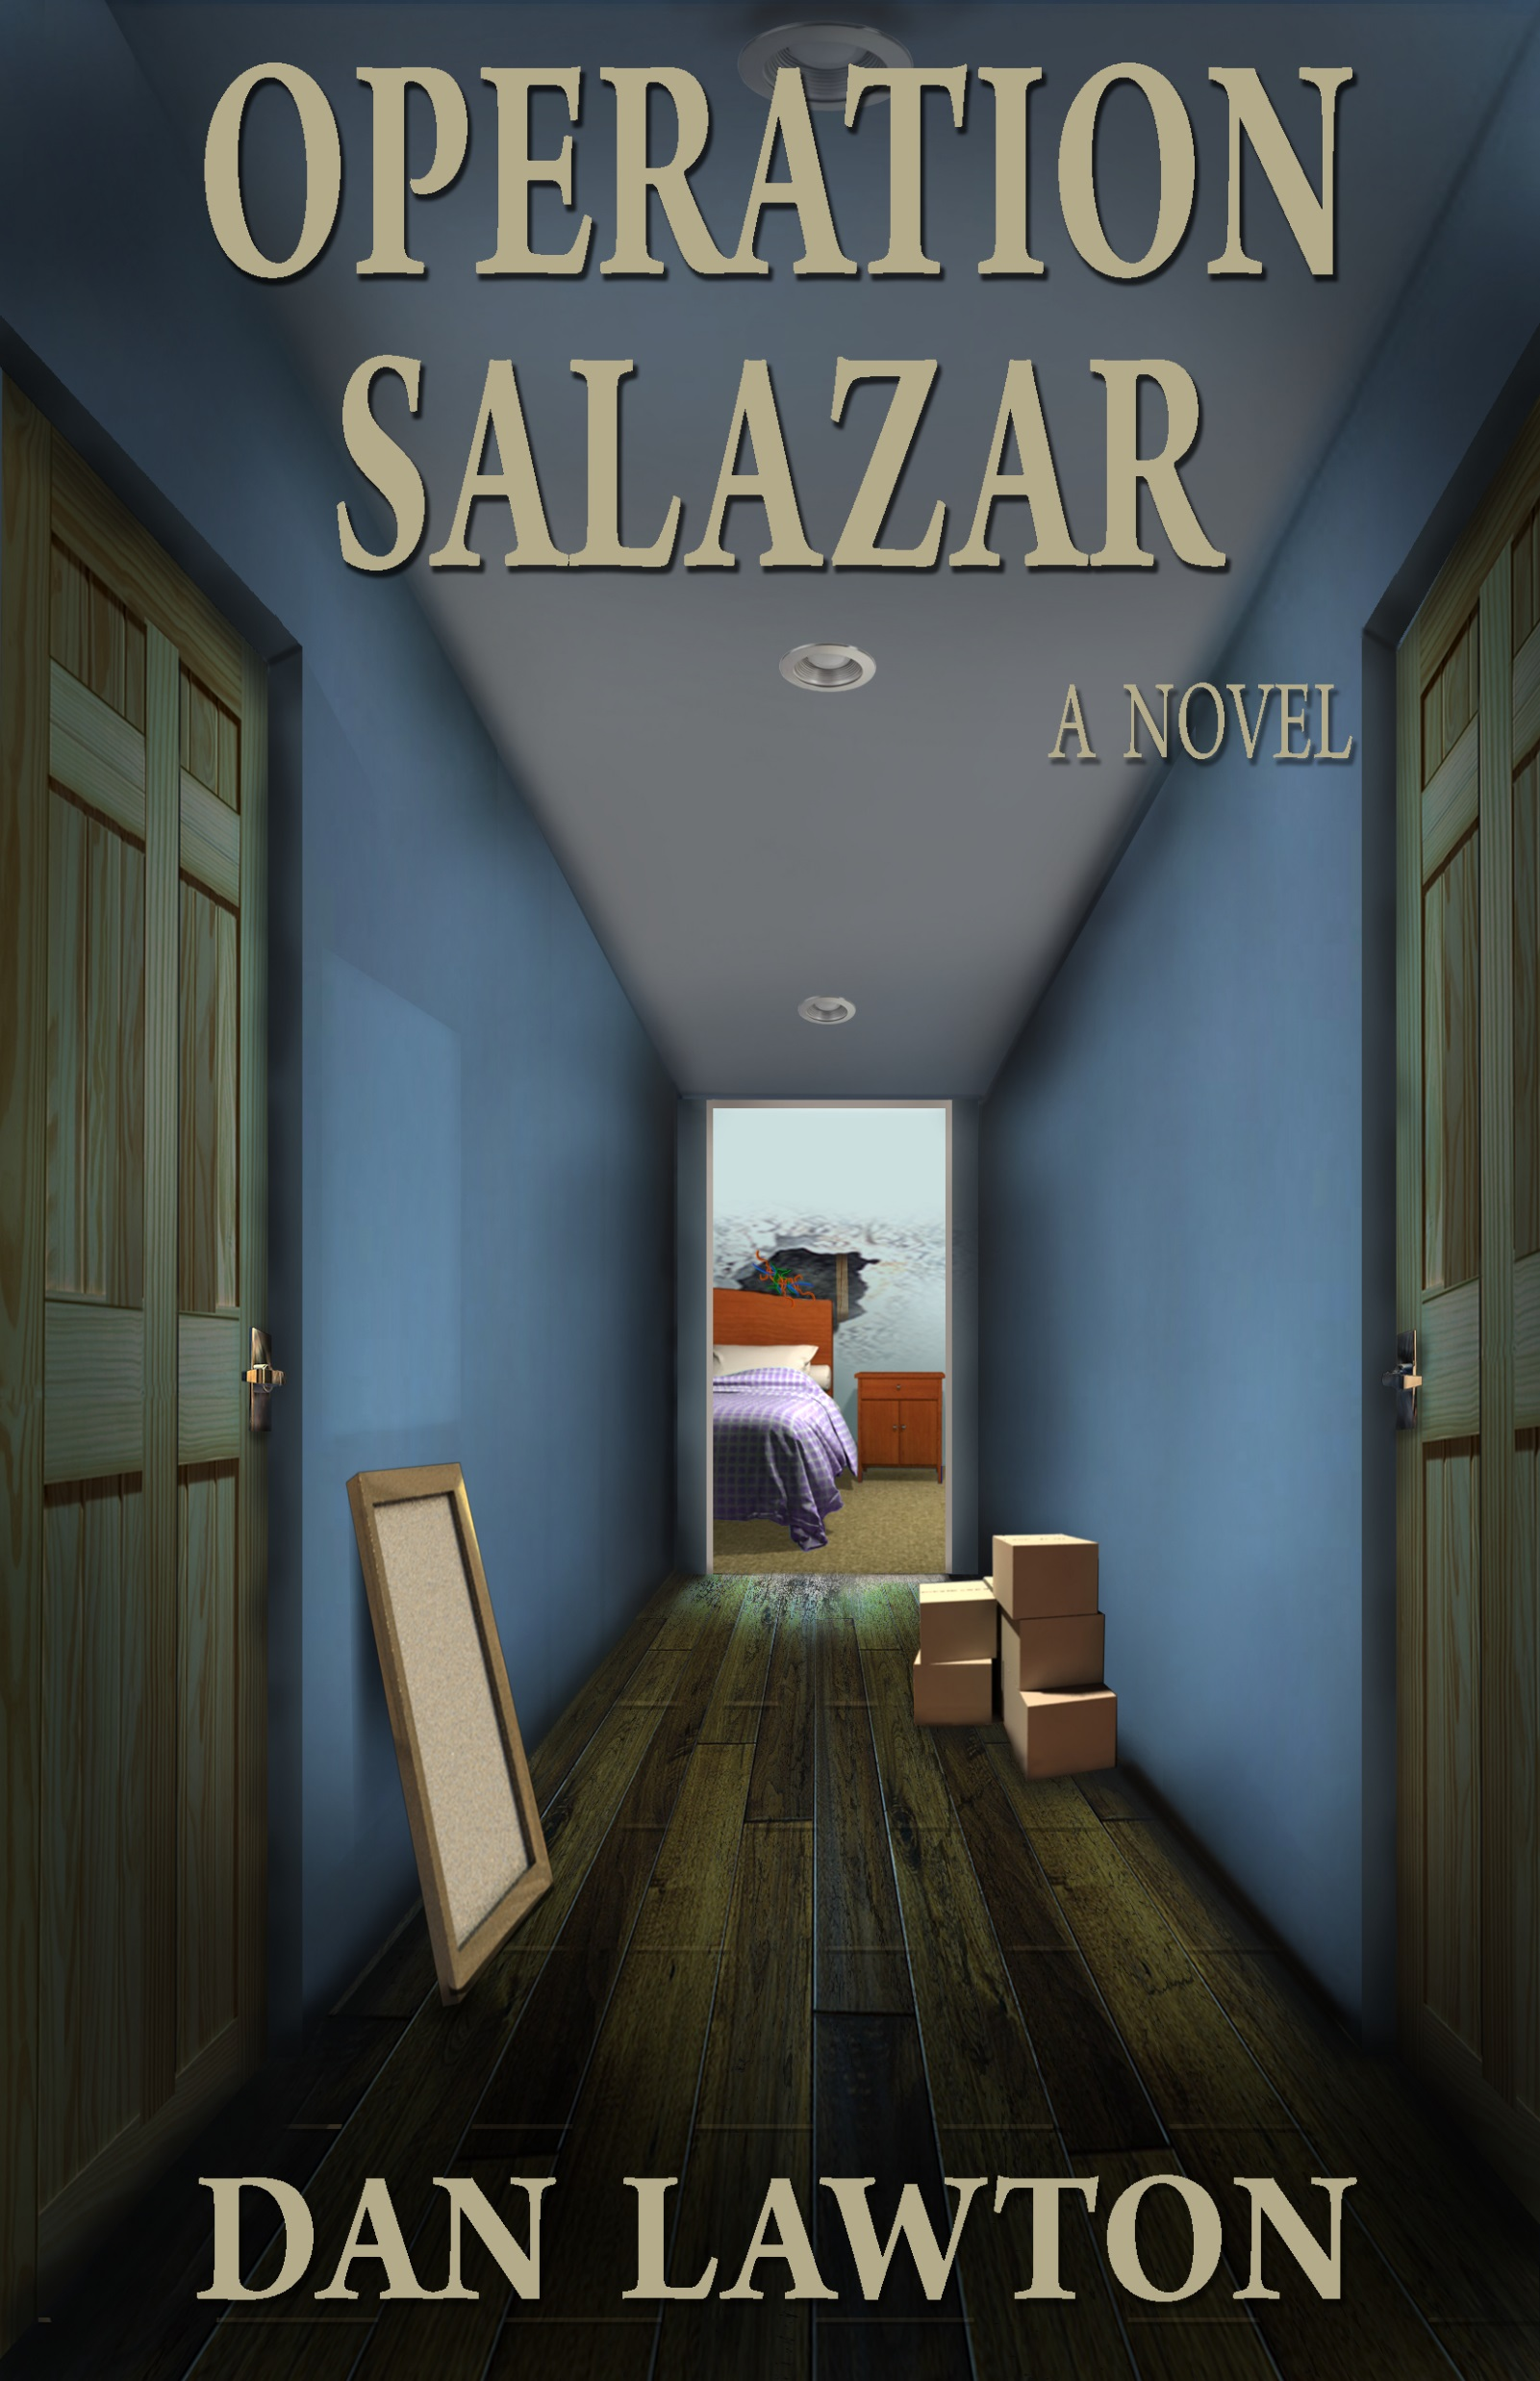
The walls have secrets. Secrets that are beyond Marco Salazar’s wildest, most unfathomable, deadliest dreams. Those walls belong to a 1941 Victorian in a quiet neighborhood on the outskirts of Boston. Uncovering the secrets threatens to unravel a whole new world that has its own set of rules, and the players who loom in the shadows are ruthless, with its net stretching even wider than Marco could have ever imagined. But with his father’s life at stake after a false imprisonment, Marco is out of options. But Marco has no idea what he’s in for. Someone is watching. And as he learns, some secrets are better left undiscovered. He’ll need all the help he can get if he’s to uncover the truth, help his father, and stay alive himself. And he’s running out of time.
Notes:
Synopsis on the screen. It’s thriller.
Took 4 months to finish. Three drafts. Finished in April 2015. Deception wasn’t published yet.
No agent luck. Didn’t spend much time though, was fine self-publishing.
Submitted to a few publishers, one gave me detailed feedback with a revise and resubmit offer.
Wrote a new draft with feedback.
Got an offer from Anaphora Literary Press, but bad vibe.
Sent manuscript, had offer within an hour.
Self-published in December 2015 (6 months after Deception)
Same process, same designer
TV show (Nashua Public Access TV) this time, more signings and press
Flop
Why? Too close together? Over saturation? Book just not good?

Slide 7
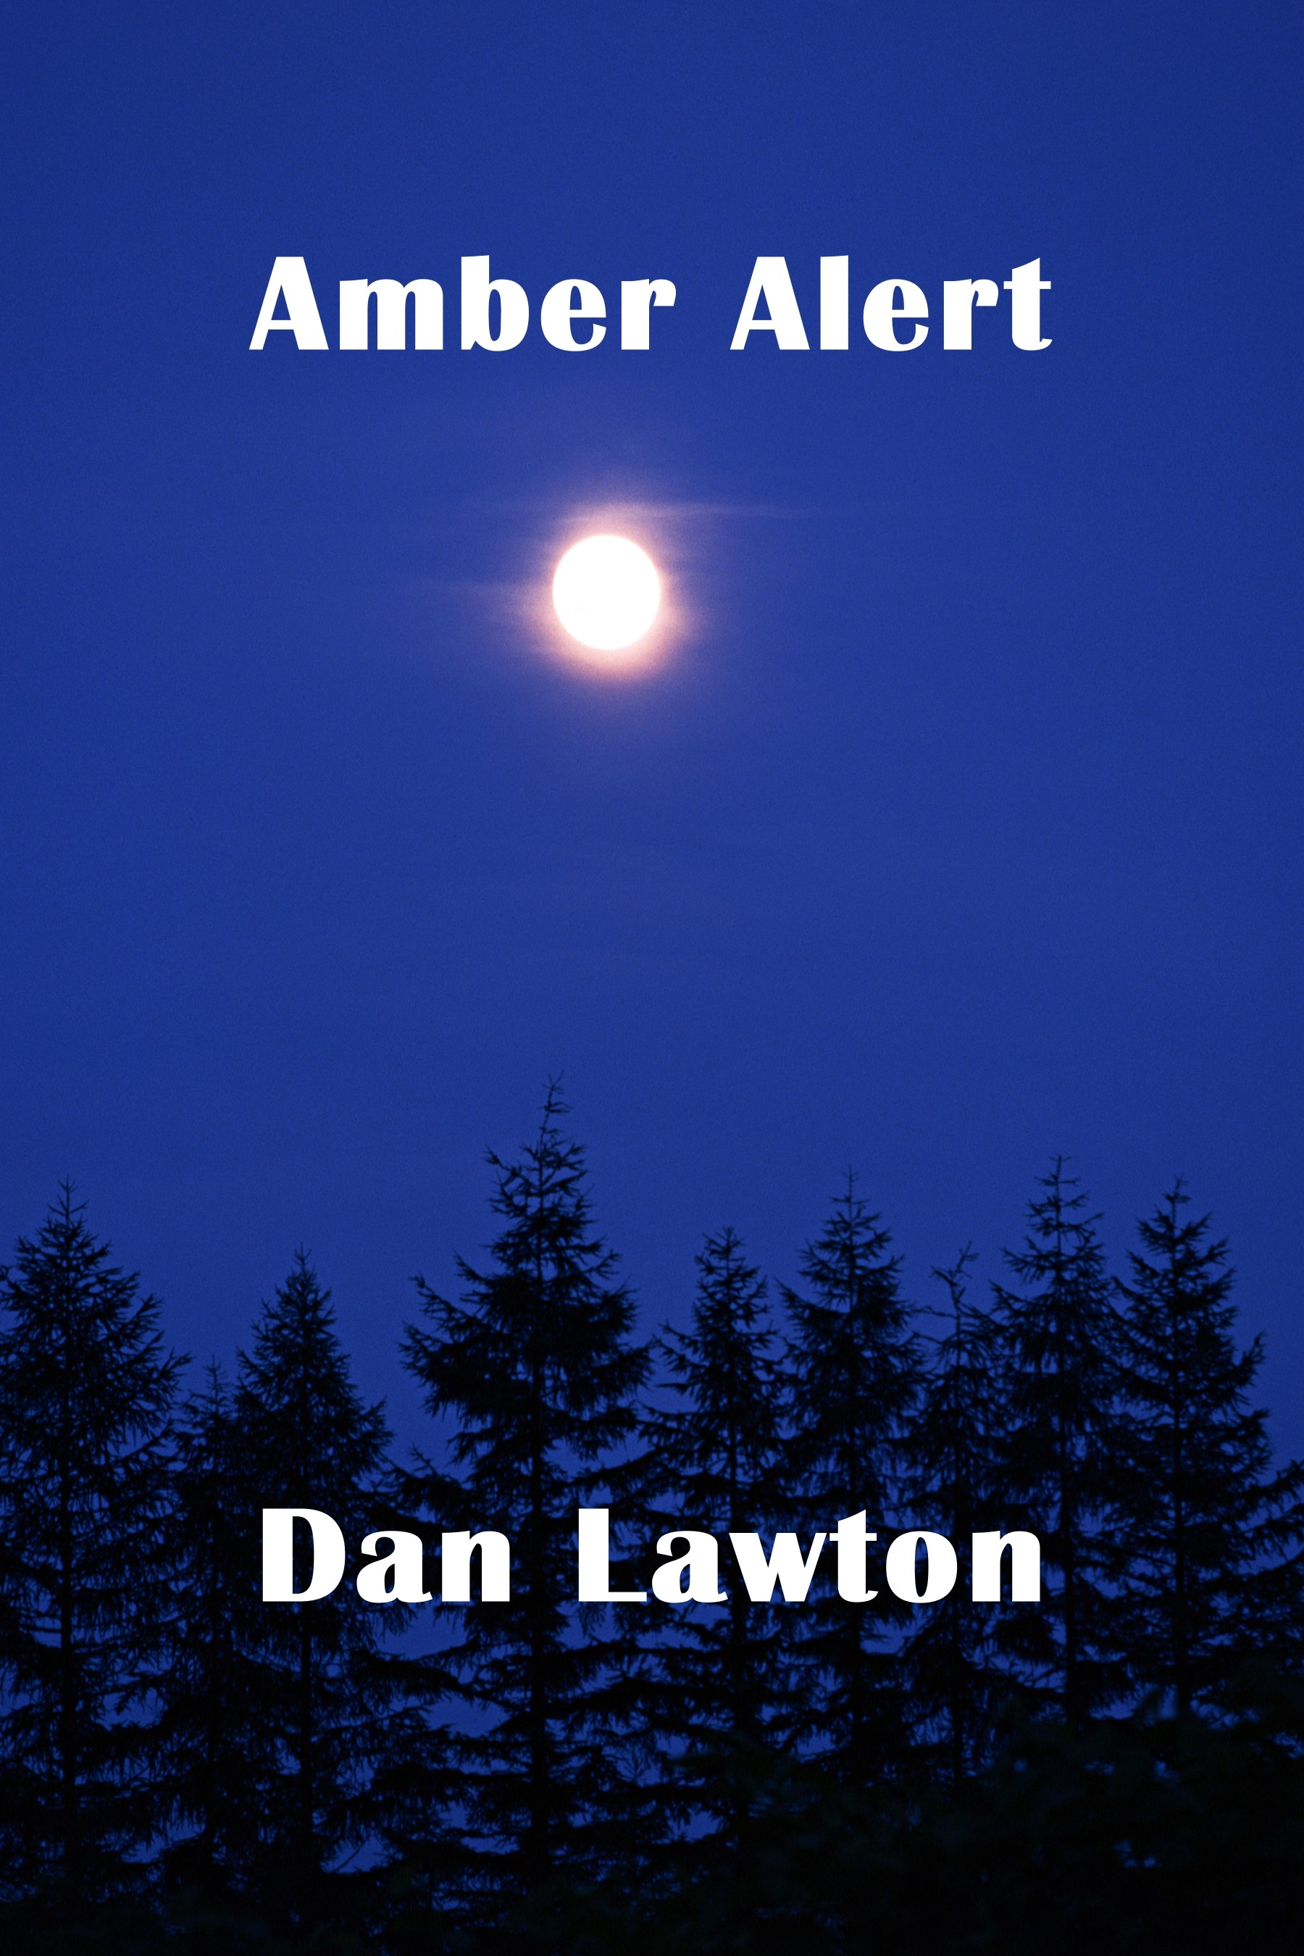
Time is running out. Nine-year-old Chloe Janis is abducted. Abby, her mom, is now faced with revealing her dark past, hidden these last seventeen years, or losing her daughter forever. A cryptic message from a man she’d shoved into the dark recesses of her mind forces her into an impossible situation—revealing secrets best kept hidden or losing her daughter forever. Secrets, deception, and betrayal surround the small town of Mifflinburg, Pennsylvania. All eyes are on the community, threatening to split open as yet unhealed wounds are probed. Fates will be rewritten and careers redefined. Everyone involved will confront their pasts if there’s any hope of Mifflinburg becoming a town at the heart of redemption and forgiveness.
Notes:
Synopsis on the screen. It’s thriller.
Took 6 months to finish. Three drafts. Finished in October 2015.
Re-evaluate goals after Salazar flop.
Spent a lot of time pitching to agents.
Had a lot of query interest.
One agent said it “sounds publishable”—first real sense of hope for getting traditionally published
Erin Niumata, Folio Literary Management
Revise and resubmit with lots of good feedback
Spend a few months rewriting and resubmitted
She wanted it, couldn’t get everyone else on the team to agree
Spent over a year querying
Tried publishers. Got Solstice Publishing offer with 5 days.
Cover design, editing, no upfront costs, royalties, no marketing help (FB group, Twitter, email newsletter, book trailer), 3-year contract up next month
POD, same distribution issues
Inclusion into ITW as Solstice is an approved publisher

Slide 8
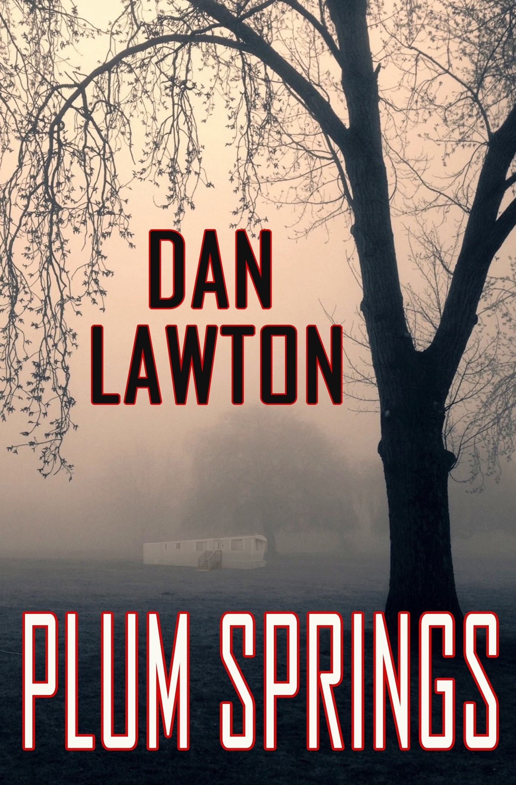
Winner of the 2019 New Hampshire Writers' Project Readers' Choice Awards for Fiction
Faced with the aftermath of a life-altering decision, a nine-year-old boy seeks solace in the Kentucky forest in pursuit of happiness, love, and acceptance.
After a lifetime of abuse, nine-year-old Rusty Travis and his older brother Bo decide their father must be stopped when, in a drunken rage, he goes after their six-year-old sister. After their vengeance is complete, they seek refuge in the tall oak forest, where they stumble upon a mysterious runaway orphan. This leads to uncovering secrets about themselves and their family they never imagined, leading Rusty to question everything he thought he knew. With his brother by his side, they battle with the demons that shatter their world in the sleepy town of Plum Springs.
Notes:
Synopsis on the screen. It’s upmarket literary suspense (suspense mixed with a higher quality of writing than genre fiction).
Took 1 year to finish. Three drafts. Finished in September 2016.
Lots of query interest right away, within days
Mark Gottlieb
Email, phone call, no contract, add 10K words (spent a 6 or 8 weeks doing it), his pitch process
Disappointment but still on editors’ desks
Moonshine Cove. Signed contract within 9 days of submission.
Unusual with having an agent
Mark’s response
Better cover, better editing, better book quality, more realistic release date
Blurbs, covers I like, Word doc of everything, 10-year contract (negotiated audio)
POD, same distribution issues
Once a year royalties, low rate
Supportive in award

Slide 9
The green house is more than a greenhouse. Seven flowers, seven colors, seven meanings, and one 37-year-old secret—the green house is the keeper of it all. Its creator, Girard, is a fragile elderly man whose life was shattered by a tragedy nearly four decades ago. And when tragedy strikes again—this time to his beloved deaf wife, Miriam—Girard struggles to cope. Miriam is missing and presumed dead, and the pain of the two interwoven tragedies drives Girard to places of his psyche he desperately tries but is unable to escape. And while the green house he constructed reminds him every day of the regret and the agony and the heartache, it’s the only place in his world that offers him peace and tranquility. As his grief slowly tortures him, he turns to the green house as his savior, and with it, he discovers the power behind it that not even he knew existed. And if he listens closely enough, he may be offered the greatest miracle of all—hope for a second chance. But is hope dangerous, or is it the greatest gift life can give? The answer could derail Girard’s existence.
The Green House
Notes:
Synopsis on the screen. It’s upmarket literary suspense (suspense mixed with a higher quality of writing than genre fiction; closer to literary).
Took 2 years to finish (stuck for a year until a larger concept came to me one night). Two drafts. Finished in November 2018.
Began querying.
Fired Mark Gottlieb first
Query interest
Max Dobson recommendation
Chad Zunker recommendation
Actively shopping
Fuze, Black Rose Writing, Moonshine Cove
Max Dobson?

Slide 10
Introduction to Self-Publishing
Notes:
Enough about me. Purpose of the rundown was to show that I’ve experienced both sides. In general, self-publishing is when the author takes control of the process—not only writing and rewriting, but also arranging editing and cover design and layout and distribution and pricing and marketing; the whole gamut.

Slide 11
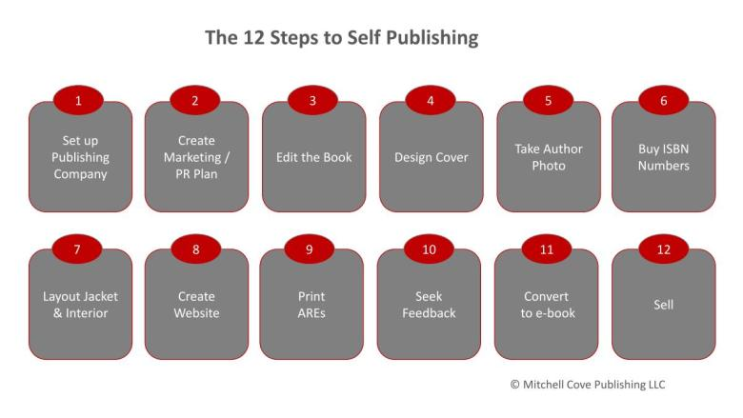
How To Self-Publish
Notes:
Before you start, ask yourself these things.
What are your goals?
What to accomplish by self-publishing?
Are you ready for all that’s involved? Entrepreneurial endeavor.
Cover design, typesetting and formatting, copy editing and proofing, accounting and taxes, distribution, PR
Before you do anything, start with social media and website and email list.
Social is free, just takes time. Need to drive people somewhere. Also need to start building an audience.
Website domain names are cheap ($10-$15 per year); website hosts can be paid (I use Jimdo, which is like $100 a year) too or there are free versions.
Mailchimp is what I use for mailing list. Lots of analytics and segmentation tools. Free to use until you get to 2K people or so. Other options too.
At this point, we’ll assume you have a completed and polished manuscript. Now come the decisions:
Formats:
E-Book
Paperback
Audio
Sometimes hardcover
Who to use? I used Amazon’s Kindle Direct Publishing since they dominate the market.
Buy your own ISBNs or use publishers?
Distribution.
Depending on the distributor, self-published books are eligible to be ordered by bookstores and libraries. Though the probably won’t. Locally they may.
Amazon, B&N, Indie bookstores (consignment), Smashwords does iTunes and Nook and libraries/Overdrive, and a bunch others. Other similar services or can upload to each directly. Smashwords has a special formatting guide that will allow one book to be used on all platforms. Super complex, but doable.
Can also sell on personal website. Though I think you’ll find you need a paid “business” account for your site to set up a store. Jimdo uses PayPal as payment, so it’s secure for everyone.
Pricing. You’ll see what you’ll make vs what the distributor will make. Fair warning: You’ll be alarmed. You don’t make that much.
Once set up: Amazon Author Pages (US and international), Amazon rankings and Bookscan, Goodreads, LibraryThing, others you’ll be active on.
Continuous marketing.

Slide 12
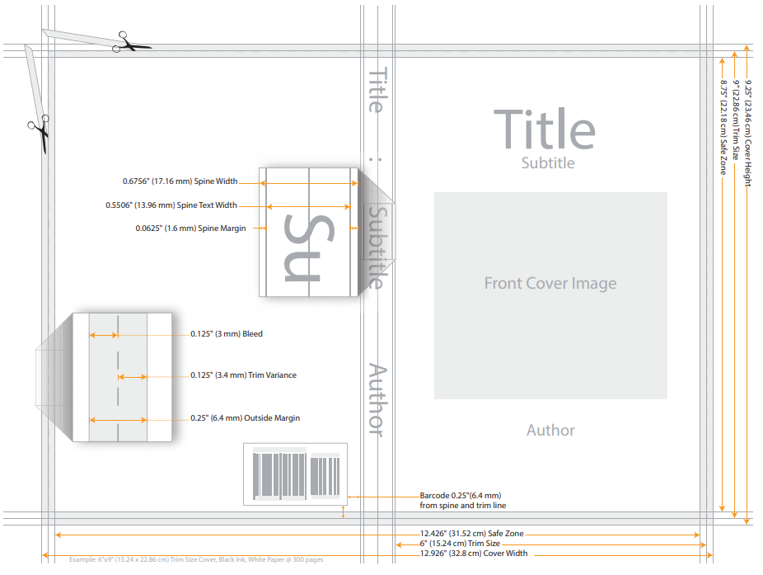
Paperback
Notes:
Upload manuscript, cover file.
What you don’t see is all the interior formatting.
Leave large enough margins for printing and binding
Blank pages and chapters starting on a certain side
Font size and style.
Justified text so text is even on right edge.
Hyphenation or not when a word extends from one line to the next.
Chapter heading and page breaks and paragraph breaks—wrong formatting with screw up the file. Especially with e-book.
This is a back cover taken right from Amazon Direct Publishing
As you can see, so many measurements and specifications.
Spine width changes based on pages in the book.
Really need a designer who know what they’re doing.
For Deception, I made the font size smaller down the line to make the book thinner and cheaper to produce and sell, so I had my designer give me the Photoshop file and I adjusted the size.
Printers do tell you the dimensions needed based on page count, so I just followed the specs with my limited Photoshop skills.
If dimensions are off, the printer will reject it. Or mistakes can happen during trimming and binding, so make sure you review a hard copy proof.
Decide the trim/book size, paper type, and color, cover finish, font size and page count and pricing impact.
So much creative freedom to decide everything. But lots of decisions to make too.
Also need a barcode with the Bowker registered ISBN. You can look up how to get a barcode that will actually work.
Keywords to make it searchable (things like thriller or murder or whatever) and categories (genre and BISAC codes, which help to identify the book’s placement in catalogues and the Library of Congress).
As mentioned before, now you decide pricing and distribution and publication date.
Hard cover would work the same way, though I’ve never done it. Amazon doesn’t offer it.

Slide 13
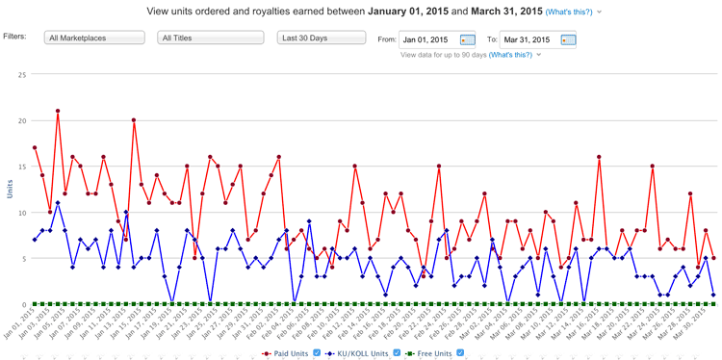
E-Book
Notes:
Dashboard on the screen is not mine. But it can be filtered, see sales history, free vs paid book. Royalty amounts are in a chart below this.
The publishing process is the same, just way easier since you’re not dealing with printed specs. Cover is just front and back.
Formatting can be wacky on different platforms though (Kindle vs. iPad vs. mobile device vs. tablet, etc.). So while the system will update it for you, make sure to thoroughly check the digital proofs to ensure the design isn’t wacky though.
As mentioned before, whether it’s Amazon (which is more straightforward) or Smashwords or others, the formatting will be different.
Something to keep in mind. If you find a typo or something, you’ll have to fix it in all file formats and reupload. Exhausting and time consuming.
Like with the physical proof, definitely use the digital preview tool Amazon provides and check to make sure there’s no formatting issues that made it through the system and mess with the formatting. If so, fix and upload and review again.
With other formats like Smashwords, their style guide is super particular and requires lots of section break and TOC links and such. Time consuming.
All that said, you’ll have real time access to sales data and you can play with pricing and royalty rates.
On Amazon, you can take 70% royalties if the book is more than $2.99. Anything less is 35%.
Kindle Unlimited is exclusive to Amazon, so e-books can’t be sold elsewhere. 90 days at a time. Allows promo opportunities. 5 free days every 90 days, countdown deals, paid ads. Free for unlimited users.
You can track live the results of the promo.

Slide 14
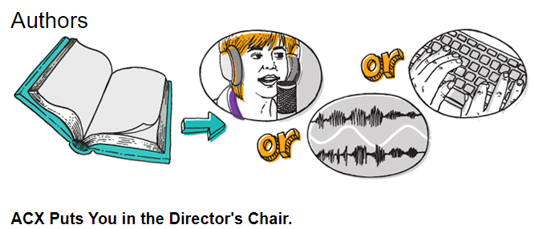
Audiobook
Notes:
Audio is an entirely different animal. I’ve only done it once. For Deception.
I used ACX, which is Audible retail. Owned by Amazon.
Basic process:
Upload sample script that has all your characters in it (or the main ones), cover, synopsis/pitch
Specify if you want accents, male/woman, certain voice tones, etc.
Open script for auditions.
Professional voice actors may like your story and send you an audio sample of them reading your script.
So weird. Such a unique experience.
If you like it, agree on contract. ACX has the exclusive rights for 7 years.
Royalty share (no cost to you) vs. flat fee (better actors since they get paid up front)
Date for when first 15 minutes are due, date for when the finished audio is due.
Price determined for you based on length in time
Publish. Actor submits files in the format ACX needs.
Bounties vs. normal sales
Sales/royalties dashboard and tracking similar to KDP.
Will need to update cover with specs of audio format, which is wider. Helpful to had Photoshop file, as I did.

Slide 15
Introduction to Traditional Publishing
Notes:
Unlike self-publishing, traditional publishing is when a publisher does the work—editing, cover design, layout, arranges distribution—and pays you royalties on books sold. Some of the larger houses pay authors an advance—which is an advance on royalties; so instead of receiving royalties on books sold, the author receives money up front. And then if enough books are sold, the author would get additional royalties once they “net out” their advance. It’s a much longer discussion.
There are some writers in the building who’ve been published by bigger houses than I, so this is only my experience. Like you, I’m interested to hear more about their experience.

Slide 16
How To Get Traditionally Published
☑ Completed manuscript
☑ Write query letter and full synopsis
☑ Research and pitch literary agents and/or publishers
Notes:
Basic steps:
For fiction, make sure the manuscript is finished. For non-fiction, this isn’t the case; non-fiction can be sold on concept. Especially if it’s a celebrity of someone with a large existing audience or platform.
Some may disagree, but I’m not in favor of hiring an editor before beginning to shop the manuscript. Reason: Both agents (some) and publishers will suggest edits, and so if you pay out of pocket for an editor, their suggestions may not be in line with what will actually sell the manuscript.
That said, the manuscript should be self-edited many times over and free of as many proofing edits as possible. Hiring a proofreader would be an option if you feel uncomfortable doing it yourself.
A query letter is essentially a one-page pitch letter that tells an agent or publisher what your book is about.
Think of it as a resume. Include brief book description, bio, credentials if applicable.
I’ll talk about these more in depth later.
Full synopsis is a more like a book jacket description. Some agents ask for a lengthy one which may include revealing the entire storyline. If that’s the case, write one.
Use the available resources to begin researching literary agents and/or publishers.
Don’t pitch them both at the same time.
Be prepared to need to prepare different materials as you query.
I’ll talk more about literary agents later.
Easy, right? No.

Slide 17
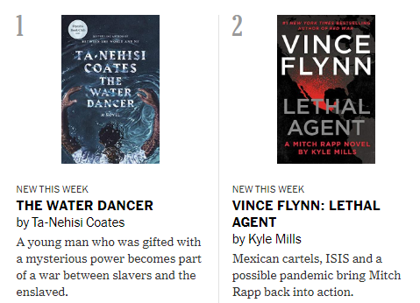
Query Letters
Ms./Mrs./Mr. Literary Agent’s First Name Last Name
Literary Agency
Agency Address
Agency City, State Zip
Dear Ms./Mrs./Mr. Agent,
1) Manuscript details, comparative titles.
2) Elevator pitch.
3) Body paragraphs.
4) Writer bio.
5) Conclusion. Signature, Name Contact information
Notes:
In the opening paragraph, share the details of your book — title, word count, genre. You can also include comparative titles here. Keep this limited to 1-2 sentences.
What's your elevator pitch, your one-liner, your hook? Put it here. It should be one sentence. NYT Best Seller List shows this wonderfully online.
Use the next two or three paragraphs to describe your book
A quick synopsis; an introduction of the protagonist, maybe the antagonist; explain the dilemma and the odds (what are the circumstances—the plot—and what are the character(s) up against. This is the meat of your query letter, and without question, the most important part. This is what will either turn an agent or publisher on, or turn them off, when it comes to your manuscript.
Don’t be afraid to toy with different lengths and variations if/when bunches of rejections come in. You WILL get rejected. A lot.
Use this paragraph to talk about your writing credentials
Who you are
Why you wrote the book (if necessary; not as common for fiction)
What your writing background is (education, relevant professional experience, other books, awards, etc.)
Keep this short, as well. 2-4 sentences depending on what your background is.
Tell the agent or publisher why you chose to submit to them
If genuine (if not, skip it), you can add in why you’re querying a certain agent (similar books, similar authors, certain connection, etc.)
Also in this paragraph, it's a good idea to reiterate that your manuscript is complete and available, should they want to read.
Also mention if you've included any materials with your email—a synopsis, for example, or sample pages—but don't do that unless you're requested to in the agent/publisher's submission guidelines.
Look at their website to find out what they want you to send to them—some want just the query letter, others want a synopsis too, and some want sample pages (5, 10, 50, maybe 100).
Send them exactly what they asked for, nothing more.
Signature line. Include all relevant contact info (name, phone, email, website, social channels).
In general, be as brief as possible.
Definitely less than one page.
Body paragraphs than 250 words.
Again, play around with different lengths and pitches though.
Lots of examples online. Also, I offer a query letter critique package on my website.
Acquired an agent.
Have gotten two different publishers and passed on offers from others.

Slide 18
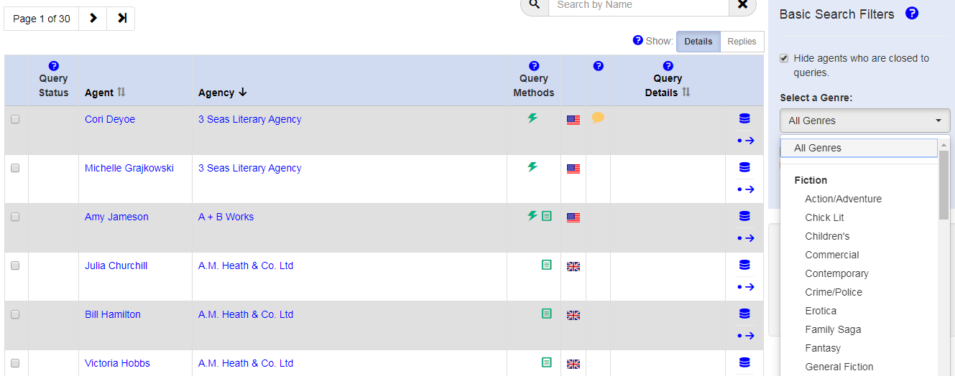
Literary Agents
Notes:
What are they? In short, they’re professionals who represent you and your work regarding publishing contracts and career advice and help with navigation of the book industry.
Look at them like real estate agents. While you can buy a house without one, it’s better to have one. They know the industry, they manage the paperwork, negotiate contracts, know who to talk to.
Some agents are part of the Association of Authors’ Representatives, other are not. They don’t have to be, but it shows more about their commitment to ethical standards if they are.
Like real estate agents, you never pay a literary agent. There are no monthly retainers or up-front fees. They make commissions on book contracts and sales (typically 15%). Which is why they are so selective—their time is limited and since they only get paid if they sell your manuscript, they want to spend their time with those books and authors who they think can make them money. Your success is their success.
Where to find them—QueryTracker, web search, books, referrals, Twitter, conferences, mentioned in author’s note in many books.
What you’re seeing on the screen is a screenshot from Query Tracker.com, which is one of the most popular and well-run literary agent databases. Can sort and filter.
When researching agents, you’ll find which genres they represent, wish lists, materials needed, formatting. Most formatting is the same.
Also large vs. boutique—a number (sometimes this means bigger sales numbers too) versus more personal attention, depending on your vision.
Query, track, monitor, follow up if needed. Can track on QT, but I use an offline spreadsheet which includes:
Agent name, agency, location, what they need in a query, their anticipated response time, authors/books they represent, when I queried them, and their response.
Lots of factors at play (timing, their workload, recent sales, industry trends, similar books already repped). Most of the time it’s a no or a no response.
Just takes one. Hundreds of nos.
What happens when they request materials?
Partials, Fulls, R&Rs, Offers
Email, call, contract, notify others
Working with them. Mark’s process.
Advantages (big publishers, editorial advice, career development—other rights, negotiate contracts, possible advance, clout)

Slide 19
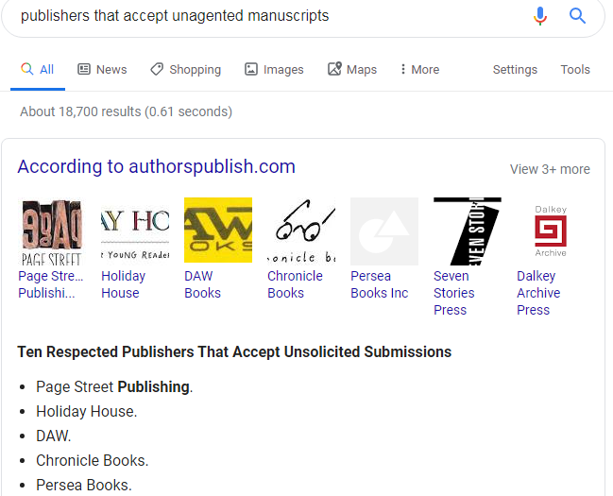
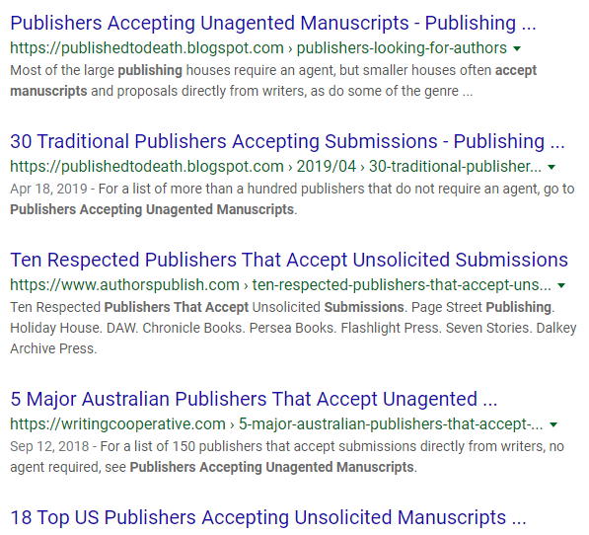
Publishers
Notes:
The process is the same really, as querying agents.
Research genres and submission guidelines (can be found on the publisher’s website)
Track, monitor, and follow up
There are even more places to find publishers though. The publisher will also be in the interior of the book.
That said, most publishers require an agent to submit to them. So that’s why it’s better to have one.
But if you don’t get one, there are plenty of independent presses that accept unsolicited and unagented manuscript submissions.
Most are independent/POD
Stay away from vanity presses (those who you pay, yet pay YOU royalties)—kill your reputation
Digital only vs. more traditional mix
Advances
Royalty rates have a big range but can be the differentiator
Sales reporting and payments
Big publishing houses a different ball game (auctions, etc.)
Working with them:
Contract, preliminary release date
Moonshine sheet with blurbs and back cover content and cover ideas and other books and author’s note
Solstice editing began right away. Moonshine came maybe a month later.
Then edits as many time as needed. Proofread a couple times.
Solstice cover was stock photo selection. Waited months for Moonshine. Sent for approval.
Once the cover comes, start hard with promotion. Set it up on Goodreads, email blast, social media, paid ads, press.
Review final proof.
Wait for launch!
Watch your Amazon ranking like a hawk!

Slide 20
Self- vs. Traditional Publishing Summary

Slide 21
Pros of Each
Self-Publishing
Traditionally Published
Higher royalties
Creative control
No deadlines, publish whenever
Hold all rights and can decide what to do with them
Success stories
Zero upfront costs
Get into associations
Award possibilities
They handle all accounting, statements
Stigma gone
Easier to get into brick and mortar stores
Notes:
SELF-PUBLISHED
Without paying a publisher or agent a percentage, you keep a lot higher rate. Still pay distributor though.
Control of cover, final editing, pricing even.
Hold all rights. All formats (hard cover, paperback, e-book, audio, MP3) and international rights. So you can do whatever you want with them
Sell it wherever.
Experiment with different covers.
Success stories
Books like 50 Shades of Gray, and The Shack, and The Martian, (among MANY others) have been international and NYT best sellers, movies, sold millions of books.
50 Shades 125 million
The Shack 20 million
The Martian unclear (35K in 6 months, which led to a book deal and a movie starring Matt Damon that made over $630 million at the box office)
TRADITIONALLY PUBLISHED
Get into associations like International Thriller Writers, mystery writers, romance writers, etc. Need a recognized publisher usually.
Similarly, certain book awards are open to only those who have been published. Leads to press and brand awareness.
Higher book quality stigma vs. self-pubbed
Easier to get into brick and mortar stores (unless POD, like small indie presses)

Slide 22
Cons of Each
Self-Publishing
Traditionally Published
High upfront costs
Time consuming
Accounting and taxes
Stigma
Lower royalties
Less control, but with input
Time to publish
Publisher attention
Notes:
SELF-PUBLISHING
Costs and time (cover, layout, ISBN, editing, maybe distribution unless POD)
Stigma—anyone can do it, can be hard to overcome quality expectation; lower quality of books stigma for readers
TRADITIONALLY PUBLISHED
Takes forever (agent, then editor; or publisher directly). Can take 2 years or more. Indie presses are quicker.
Lost in a sea of A- and mid-listers, huge number of books published each year

Slide 23
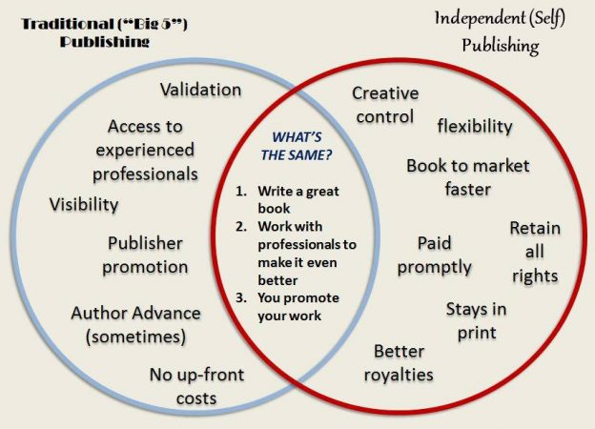
Which is Better?
Notes:
My conclusion: Traditional publishing
Why?
Costs
If you spend all this money on cover design and editing and typsetting, it may not leave much left for promotion
Stigma
Leads to bigger things (job, freelance editing, next book deal)
Publisher does the behind the scenes work, you worry about writing and marketing
Literary agents can open up a whole new world, new opportunities
Though a hybrid model is one that’s become popular based on the needs, goals, and vision of an individual project
My gig with Max
Some famous authors have done it (Stephen King, Edgar Allan Poe, Mark Twain, Margaret Atwood [The Handsmaid Tale])
Once you have an audience, it could be a reasonable option to make significantly more money—which will entice publishers to pony up more money up front to keep them. A win-win.
If you’re a marketing whiz, either will work and you may be better of self-pubbing

Slide 24
Key Learnings
Marketing expectations
Keep writing for relevance
Everything is a learning experience
Always-on
Be willing to try new things
Getting an agent is more difficult than getting published
Keep on keepin’ on
Notes:
Having been through both self- and traditional publishing (indie publishers), this is what I’ve learned:
Marketing expectations
Most difficult part
Publisher help not very good
Keep writing for relevance
Next one builds on what came before
Gain more fans
More media, more opportunities for publicity
Slowly grow following; it’s the long game
Everything is a learning experience
Most things you do won’t earn you money, or much. You may lose money. But it’s all experience.
I once did a book signing and one person showed up. She didn’t buy anything. It can bum you out, but it’s all part of the journey.
Don’t expect early success. It happens, but it’s the exception.
No regrets. If it doesn't work, so what? Now you know.
The more you do, the more familiar you are with the industry and how it works.
Take me. 5, 6 years ago I knew nothing. Now look at me. Was invited to speak here today. Long way to go.
Always-on
Marketing never stops. You’re a brand.
Social media every day.
Always be ready to talk about your books.
Get a business card.
Always try new things
Branch out with marketing ideas, with story ideas, with connecting with fans and industry professionals
No one’s going to know about you if you don’t put yourself out there.
Scary, I know. But worth a shot. Worst is “no” or no response. You may be surprised how many yesses you get, especially with the supportive NH writing community.
Getting an agent is more difficult than getting published
It’s like getting the first job after college. Hard to get a job without experience, only way to get experience is for someone to give you a chance.
For me, self-publishing was like my internship into the industry. Those led to some industry knowledge, which led to the first deal, which led to the next and the agent and the award and whatever comes next.
Keep on keepin’ on
Don’t give up.
You’ll be told “no” more than “yes” guaranteed. Just takes one “yes.”
The only way to get better is to keep doing it. So do it. Keep writing.
I’ve heard of writers who have written a dozen or more (one guy his 18th) before getting published. Everyone’s journey is different, and that’s okay.

Slide 25
Wrap Up
Website: www.danlawtonfiction.com Email: info@danlawtonfiction.com
Twitter/Instagram: @danlawtonauthor Facebook: facebook.com/danlawtonfiction
Notes:
Ton of information today, only the tip of the iceberg. We’ll all learn something today, no question. Thanks for being here and for listening. And to the library for the invite.
Writing leads to other ways to expand personal brand and business.
Freelance writing, editing, speaking gigs, etc.
For me, I learn something new every day.
Hired a social media specialist. Thinking about hiring a publicist for my next book.
Plan to redesign my website
Anyone in this room who wants to get in contact, info on the screen.
Offer query service ($10 one-time, $25 unlimited)
Freelance fiction editing and proofreading
Have a handful of copies of Plum Springs.
Had more, but they were taken unexpectedly at the Literary Awards.
For other books, I have a sign-up sheet. Leave your info and I can sign them and ship them to you. Or order online. E-books and paperback. Deception is audio,
I’ll be around at the end for the book marketplace.
Open it up for questions, after my final spiel.

Slide 26
Questions? Let’s chat.

